Slide 1


SMART INDIA HACKATHON 2025
SMART NAVIGATION FOR INDIA
Problem Statement ID – 25100
Problem Statement Title- Accelerating High-Fidelity Road network modelling for Indian Traffic Simulations
Theme- Transport and Logistics
PS Category- Software
Team ID- KLHB-SIH-011
Team Name: NavEdge

Slide 2
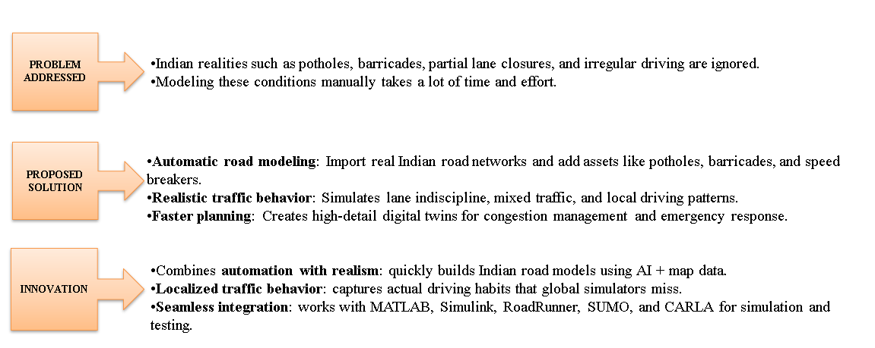
SMART NAVIGATION FOR INDIA
NavEdge

Slide 3
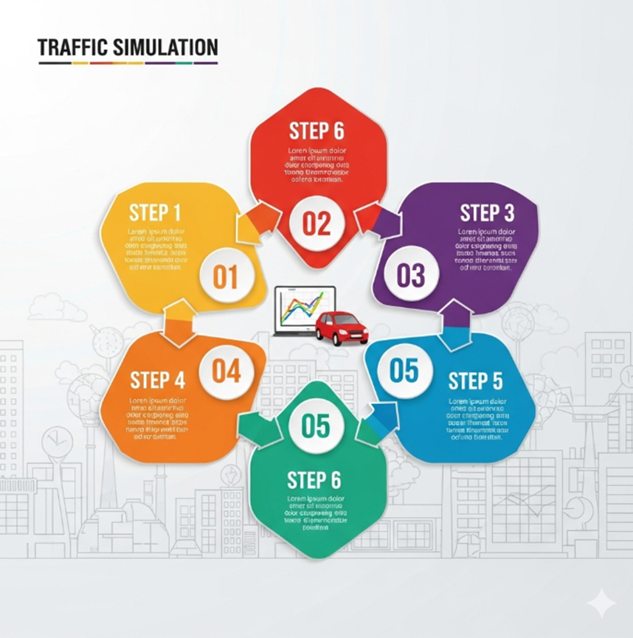
TECHNICAL APPROACH
NavEdge
Technologies to be used
Programming: Python
Frameworks/Libraries: Network(graph modelling), SUMO/Custom Simulation, Matplotlib.
APIs: OpenStreetMap for road data
UI: Simple Web/App interface
Methodology & Process
Extract road network from OpenStreetMap.
Represent as graph → nodes (intersections), edges (roads).
Integrate real-time obstacle data (potholes, barricades, diversions).
Run traffic simulation → identify congestion & alternate paths.
Display results on a user-friendly navigation interface.

Slide 4
FEASIBILITY AND VIABILITY
NavEdge
Feasibility
Uses open-source data (OSM, public datasets).
Implementable with widely available tech (Python, APIs).
Prototype can be developed within hackathon timeline.
Potential Challenges & Risks
Real-time obstacle data collection.
Scaling simulation from local roads to metro cities.
Handling unpredictable Indian traffic behaviours.
Strategies to Overcome
Start with small-scale road networks (few junctions).
Integrate user/community reporting for obstacle data.
Future integration with IoT sensors & govt. databases.

Slide 5
IMPACT AND BENEFITS
NavEdge
Impact:
Commuters: Safer, faster travel with obstacle-free routes.
Government/Planners: Better data for road maintenance.
Environment: Reduced fuel wastage due to jams/diversions.
Benefits:
Social: Improves road safety, reduces stress for drivers.
Economic: Saves billions lost to traffic delays.
Environmental: Lower emissions from optimized travel routes.

Slide 6
RESEARCH AND REFERENCES
NavEdge
NITI Aayog report on traffic congestion costs in India (₹1.47 lakh crore loss annually).
OpenStreetMap (OSM) for road network data.
SUMO (Simulation of Urban Mobility) traffic simulation framework.
Academic papers on graph-based road modelling and agent-based traffic simulation.
Google Maps/Navigation limitations (blog & research comparisons).

Slide 7
IMPORTANT INSTRUCTIONS
Please ensure below pointers are met while submitting the Idea PPT:
Kindly keep the maximum slides limit up to six (6). ( Including the title slide)
Try to avoid paragraphs and post your idea in points /diagrams / Infographics /pictures
Keep your explanation precise and easy to understand
Idea should be unique and novel.
You can only use provided template for making the PPT without changing the idea details pointers (mentioned in previous slides).
You need to save the file in PDF and upload the same on portal. No PPT, Word Doc or any other format will be supported.
Note - You can delete this slide (Important Pointers) when you upload the details of your idea on SIH portal.

